Slide 1
Hands On Lab!
60 minutes

Slide 2
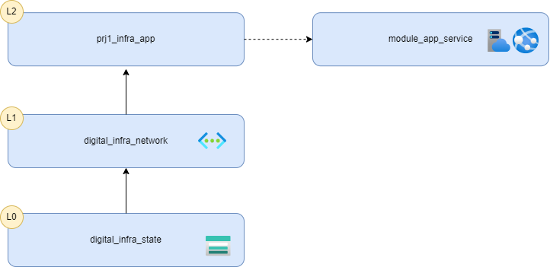
Migrate the App Service to a module
Back in your prj1_infra_app create a new folder called modules and inside another one called app_service
The goal is to provide a module for app service that manage the VNet integration.
In this module, create a main.tf and put the app.tf file content into it.
Create a variables.tf and an outputs.tf
Move also the pe.tf inside this module

Slide 3
Migrate the App Service to a module
Update all the local properties in the modules
Make the app service plan sku a parameter of your module
Add two outputs to your module: the app service id and app service default hostname
Reference the new module in the app.tf of your prj1_infra_app folder
Make sure to migrate the module without creating or deleting any resource
You may have to use a lifecycle block
Run terraform plan and terraform apply you should have no changes

